Slide 1
Introduction to NoSQL stores

Slide 2
Change of Direction
In this lecture we are describing a totally different type of big data.
In the previous 8 lectures we were focused on big data analytics.
Where we copy the data into HDFS and then perform various kinds of read-only queries on it. Like
Aggregation: count, sum, etc.
Selection: find the lines of text that have a certain property, etc.
In this lecture we will be focused on huge amounts of data updates (change value, insert row, delete row). E.g
EBay auctions and purchases
Facebook posts
Any kind of updates to online web sites by potentially millions of users.

Slide 3
Why MapReduce and Spark are not good for updates
MapReduce and Spark are designed for analyzing data
Data analytics perform mostly read-only operations
Do not handle multiple concurrent updates.

Slide 4
Properties of NoSQL Stores
Need to give good user experience
Unlike analytics software, NoSQL systems usually are used directly to serve user requests
Scale
Can scale out to 1000s of machines
Handle failures
Network partitioning
Node failures
High availability
System needs to be always available to keep customers happy.
Even brief unavailability can turn away a lot of users.
Need more nines of reliability

Slide 5
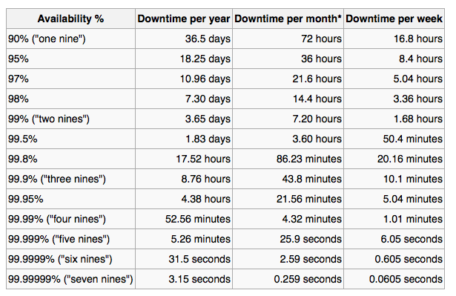
High Availability (More 9s please)
Significant down time per year even if a system is available for a high percentage of the time.

Slide 6
Low Latency
Systems need to respond within 100ms for it to feel fluid and natural to the users.
What can cause high latency?
Shared resources
Background daemons
Maintenance activities
E.g. garbage collection
Queuing
Multiple layers of queues
CPU slow down when reaching their thermal limits
etc.

Slide 7
Low Latency
Large-scale online services do the following to reduce latency
Break request up into many small sub-tasks.
Each sub-task executed on a different machine
This approach can cause high end-to-end latency for users.
E.g. Server typically responds in 10ms but for 1% of time it takes 1 second.
Means 1 request in 100 will be slow (one second)
If a user request must collect responses from 100 such servers in parallel then 63% of user requests will take more than 1 second!
This slide is based on the material from this paper
Jeffrey Dean, Luiz Andre Barroso, The tail of scale, Communications of the ACM, 2013.

Slide 8
Properties of NoSQL Stores
Large number of updates
Need to support thousands of updates per second. Give users low response time
Consistency model
Full ACID transactions are nice but often too costly to support for NoSQL stores
Support for joins
Many NoSQL stores do not support joins since they are too expensive to execute at large scale.
Data model
Different NoSQL stores support different data models
Key-value stores, column families, tables, documents.

Slide 9
Properties of NoSQL Stores
Indexing
All NoSQL stores offer indexing for at least the primary field (key). Some also offer secondary indexes.
In contrast, MapReduce and Spark do not offer indexing.
Typical usage of MapReduce combined with NoSQL.
Use MapReduce to create an inverted index of words to documents.
Stored the index in the HBase NoSQL Store
At query time lookup word in the index stored in HBase.

